Slide 1
Embedded Systems with ARM Cortex-M Microcontrollers in Assembly Language and C
Chapter 11
Interrupt, Timer and PWM
Exercises ANS
Z. Gu
Fall 2025
Acknowledgement: Lecture slides based on Embedded Systems with ARM Cortex-M Microcontrollers in Assembly Language and C, University of Maine https://web.eece.maine.edu/~zhu/book/

Slide 2
Interrupt
Suppose register i (i ≤ 12) is initialized to have a value of i (e.g. r0 = 0, r1= 1, r2 = 2, r3 = 3, etc.). Assume the main stack (MSP) is used. (Recall: in the interrupt handler, if LR = 0xFFFFFFF9, then the main stack (MSP) is used. If LR = 0xFFFFFFFD, then the process stack (PSP) is used. ) The program status register (PSR) = 0x00000020, PC = 0x08000020, and LR = 0x20008020, when the interrupt occurs.
(1) Show the stack content immediately before the PUSH instruction runs. Suppose the stack pointer SP, i.e. MSP in this case, was 0x20000600 immediately before the system timer interrupt occurs
(2) What are the values of these registers (R0-R12, LR, SP, PC, and PSR) immediately after the interrupt exits?
SysTick_Handler PROC EXPORT SysTick_Handler PUSH {lr, r0, r7} ADD r0, r0, #1 ADD r1, r1, #1 ADD r2, r2, #1 ADD r3, r3, #1 ADD r4, r4, #1 ADD r5, r5, #1 ADD r6, r6, #1 ADD r7, r7, #1 ADD r8, r8, #1 ADD r9, r9, #1 ADD r10, r10, #1 ADD r11, r11, #1 ADD r12, r12, #1 POP {r0, r7, pc} ENDP

Slide 3
Interrupt ANS
(1)
0x20000600
0x200005FC | 0x00000020 (PSR)
0x200005F8 | 0x08000020 (PC)
0x200005F4 | 0x20008020 (LR)
0x200005F0 | 12 (R12)
0x200005EC | 3 (R3)
0x200005E8 | 2 (R2)
0x200005E4 | 1 (R1)
0x200005E0 | 0 (R0)
0x200005DC

Slide 4
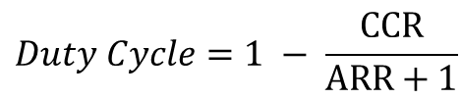

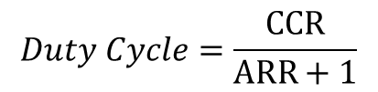
Summary of Equations
Timer clock frequency $f_{CK_CNT}$ vs. CPU Clock Frequency $f_{SOURCE}$
$$f_{CK_CNT}=\frac{f_{SOURCE}}{PSC+1}$$
Timer frequency $fTimer$ with up-counting or down-counting mode:
$$fTimer=\frac{f_{CK_CNT}}{ARR+1}; Timer Period=\frac{ARR+1}{f_{CK_CNT}}= \left(ARR+1\right)∗Clock Period$$
Timer frequency $fTimer$ with center-aligned counting mode:
$$fTimer=\frac{f_{CK_CNT}}{2∗ARR};Timer Period=\left(2∗ARR\right)∗Clock Period$$
PWM duty cycle for Mode 1 (Low-True):
$$Duty Cycle=\frac{CCR}{ARR+1}$$
PWM duty cycle for Mode 2 (High-True):
$$Duty Cycle=1 − \frac{CCR}{ARR+1}$$

Slide 5
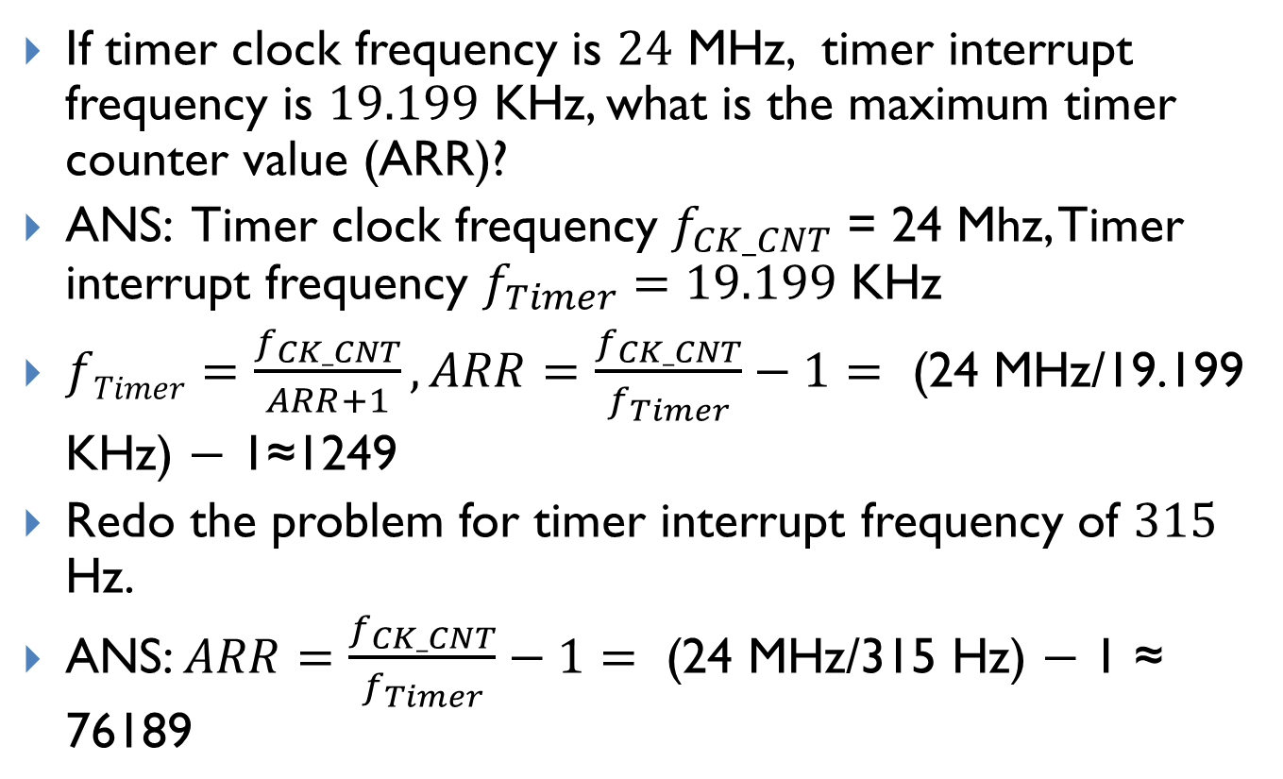
Timer
If timer clock frequency is $24$ MHz, timer interrupt frequency is $19.199$ KHz, what is the maximum timer counter value (ARR)?
ANS: Timer clock frequency $f_{CK_CNT}$ = 24 Mhz, Timer interrupt frequency $f_{Timer}=19.199$ KHz
$fTimer=\frac{f_{CK_CNT}}{ARR+1}, ARR=\frac{f_{CK_CNT}}{f_{Timer}}−1=\text{ (24 }\text{MHz}\text{/19.199 }\text{K}\text{Hz}\text{) − 1≈1249}$
Redo the problem for timer interrupt frequency of $315$ Hz.
ANS: $ARR=\frac{f_{CK_CNT}}{f_{Timer}}−1=\text{ (24 }\text{MHz}\text{/315 }\text{Hz}\text{) − 1 ≈} \text{76189}$

Slide 6
Timer
a) What value should you use for ARR to get a SysTick timer interrupt every 70ms on a processor LP1768? (6 points)
b) If you used the same value for ARR from part (a) but ran that code on a newer microcontroller featuring a 500 MHz Cortex M4 processor, how often would SysTick interrupts occur? (4 points)

Slide 7
Timer ANS
Q. What value should you use for ARR to get a timer interrupt every 70ms on a processor with CPU frequency of 100 MHz (no prescaler)?
ANS: Timer period is determined by the formula: T = (ARR + 1) / CPU_frequency (no prescaler)
ARR = (T * CPU_frequency) – 1 = (70 * 10⁻³ s) * (100 * 10⁶ cycles/s) - 1 = 6,999,999.
Q. What is the timer period, if you used the same ARR value on a 500 MHz processor?
ANS: T = (6,999,999 + 1) / (500 * 10^6 cycles/s) = 0.014 s = 14 ms

